Slide 1
ArcGIS Desktop app

Slide 2



Software
Esri ArcGIS is a geographic information system (GIS) app that applies data to maps to help users visualize spatial and locational information. It is available for academic use only, both online and via desktop software, to Rutgers faculty, students, staff, and affiliates.
ArcGIS allows users to build interactive maps that illustrate their data in three dimensions and over time. Built-in analytical tools help reveal relationships, identify prime locations, calculate optimal routes, and analyze patterns to make predictions. The software is also designed to make it easy for users in different locations to collaborate and for map creators to share their maps with anyone.
Login Instructions AGO_Account_Creation.pdf (rutgers.edu)

Slide 3
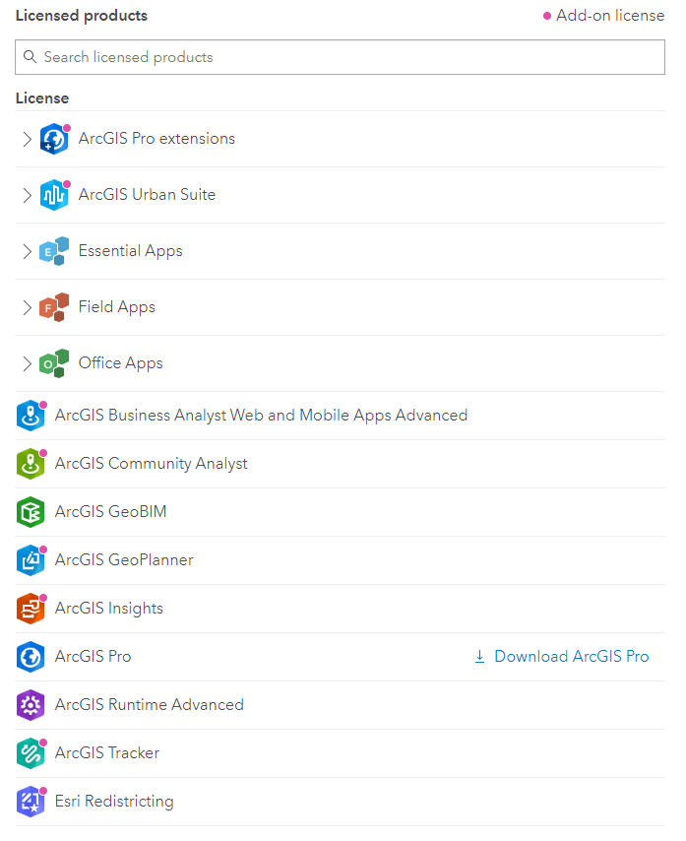

Slide 4
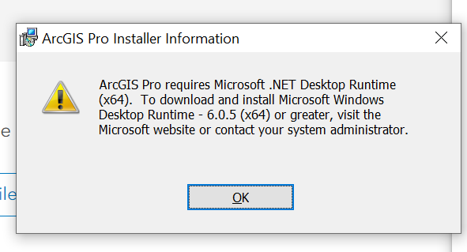
Access to ArcGIS online and ArcPro uses Single Sign On authentication using Rutgers NetID/Password.
More information can be found at the Rutgers Software Portal.
Create an ArcGIS Online/ArcGIS.com account using Single Sign On (SSO) via Rutgers NetID
Go to: https://rutgers.maps.arcgis.com
Click the Sign In button on the upper right
Click on the Rutgers University NetID Login button
Enter your NetID and NetID password and click the Log In button
Download ArcGIS Pro
Go to: https://rutgers.maps.arcgis.com
Sign into ArcGIS Online
Click on your username
Click 'My Settings'
From the list of assigned licenses, next to ArcGIS Pro, click 'Download'
Complete the installation as directed
Create an ArcPro account using Single Sign On (SSO) via Rutgers NetID
Open ArcGIS Pro
At the ArcGIS Sign In screen, click on the Your ArcGIS organization’s URL button
At the next screen, enter rutgers in the box
Check the Remember this URL box and click Continue
Click the Rutgers University NetID Login button
Enter your NetID and NetID password and click the Log In button
ArcMap download and Single User license*
Requires a Windows operating system. Please sign into the Rutgers Software Portal
Download and read the ESRI Activation Instructions
Download the ESRI Desktop executable file and the ESRI License file
Follow the activation instructions to install the application
*please note: ESRI is actively working to deprecate ArcMap. This software will soon no longer be supported or available for updates.
ArcMap and ArcPro are also available through the The Rutgers Virtual Computer Labs and in most general Rutgers computing labs if a Windows OS or larger compute environment is needed.

Slide 5
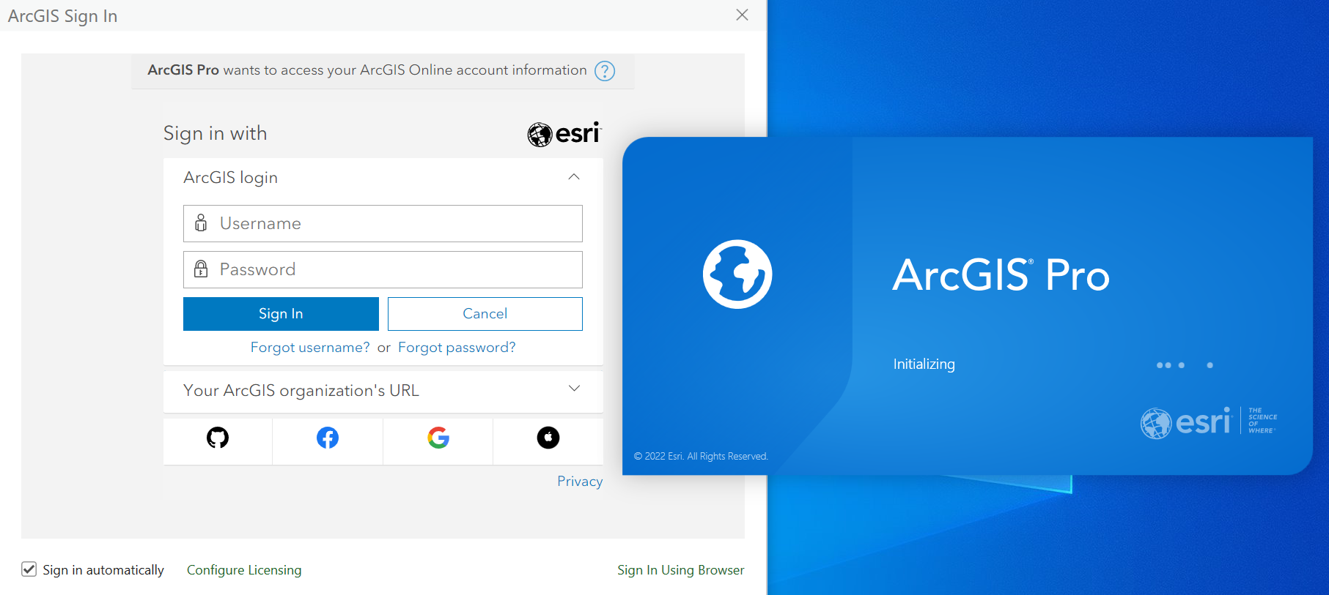

Slide 6
